Slide 1
Ecovillages for sustainable rural development
Zivile Gedminaite-Raudone
Lithuanian Institute of Agrarian Economics
17th September 2012

Slide 2
Our planet is composed of
Place
Man
Energy & materia

Slide 3
Place
Energy & Materia
Sustainable economy
Man

Slide 4
PLACE
Natural environment (land, water, flora, fauna)
Built environment (history, buildings, technology)
ENERGY & MATERIA
Optimal use of energy (renewable resources)
Closed natural cycles (water, air, materials)
MAN
Social patterns (habits, knowledge, skills, experience, networking)
Collaboration synergy (integrated work, cross-science, know-how, democratic and responsible cooperation, creativity)
Minimizing need for transportation (people, goods)
Clean and healthy processes (natural cycles)
Aesthetical and psychological beauty

Slide 5
Nowadays people start thinking of being more…
Ecovillage Movement
Socially responsible
Economically responsible
Ecologically responsible

Slide 6
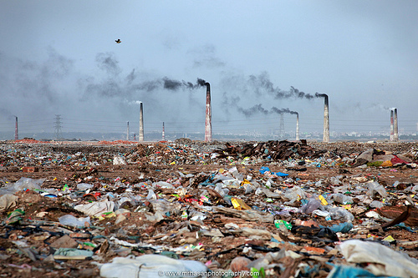
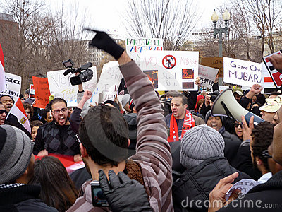
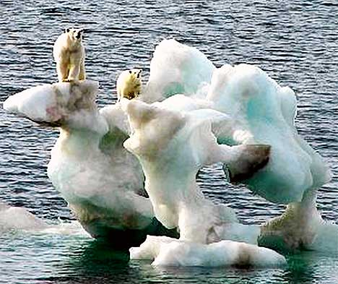
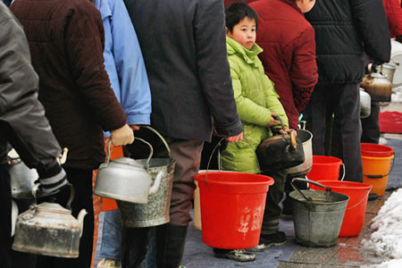
Ecovillage concept deals with
Climate change
Environmental pollution
Resource shortages
Social problems
http://www.flickr.com/photos/mrhasan/5640403396/
http://www.dailymail.co.uk/news/article-500424/Polars-bears-brink-Dont-believe-it.html/
http://chinadigitaltimes.net/2008/02/photos-endless-queue-for-water-in-wuhan-after-the-snowstorm//

Slide 7
www.realmagick.com/post-materialism/
www.ipeacemeal.com/
Ecovillage Movement suggests an alternative idea to the individualistic, materialistic and consumer-oriented lifestyle

Slide 8
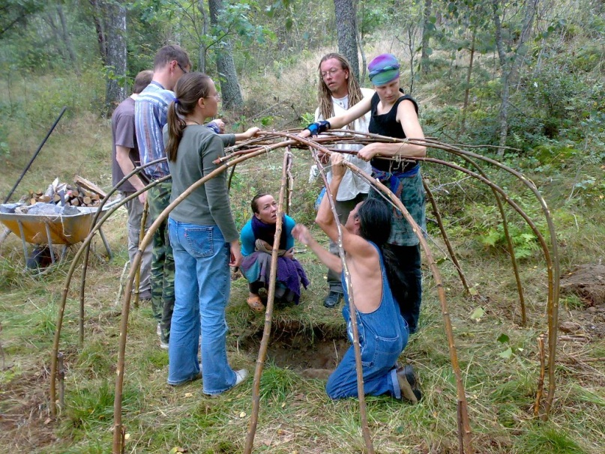
Ecovillage principles aim at combining sociocultural environment with a low–impact way of living.

Slide 9
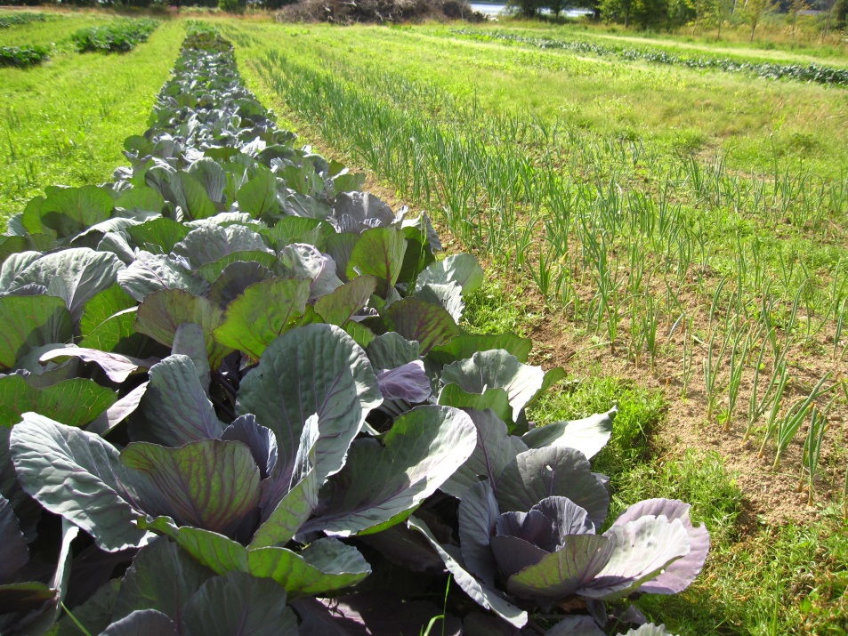
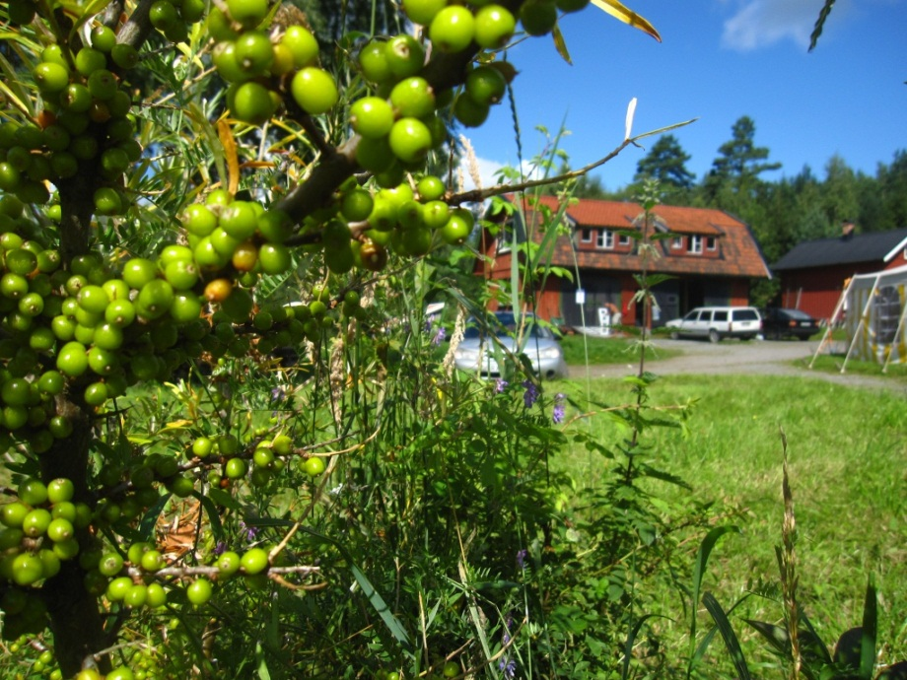
Ecovillages are important element of sustainable rural development in BSR and beyond.

Slide 12
Planet needs
People ideas
Project “Ecovillages for sustainable rural development”

Slide 13
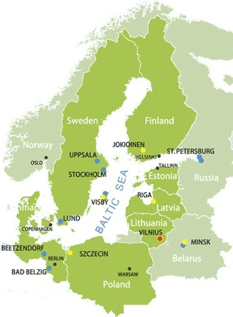
Partnership and cooperation area

Slide 14
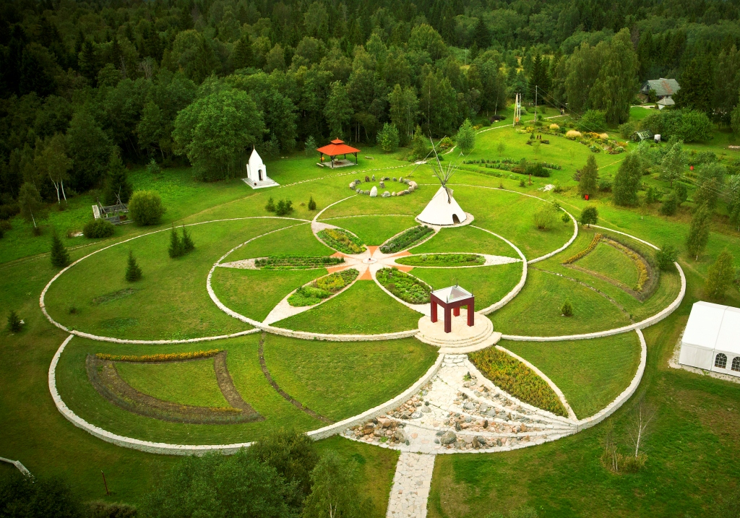
Aim
Project aims at fostering ecovillages development as a more sustainable way of living in rural areas of the Baltic Sea Region

Slide 15
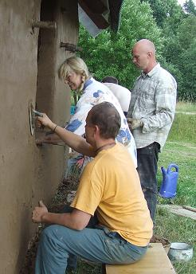
Aim will be achieved by…
… collecting and transferring innovative concepts and best practices from the Ecovillage Movement to the society
Knowledge transfer
http://timmonsandcompanyblog.com/2011/05/23/people-people-people/
http://www.zazzle.com/people_world_sticker-217461968541164079

Slide 16
Outputs:
2 manuals
Self-assessment tool
Recommendations
Internship programmes
Ecovillage road
http://aacable.wordpress.com/2012/02/28/howto-view-and-kill-tasks-on-localremote-pc/

Slide 17
Manuals
… covering guidelines for eco-settling practices and nature – friendly technologies
Eco-building
Waste & sewage management
Food production & consumption
Renewable energy
Etc.
… covering guidelines for community living and social development in ecovillages
Stages of life-cycle in ecovillage
Decision making
New-comers
Traditional festivals & events
Etc.
http://www.guardian.co.uk/books/booksblog/2009/jan/23/best-list-novels-1000-explained

Slide 18
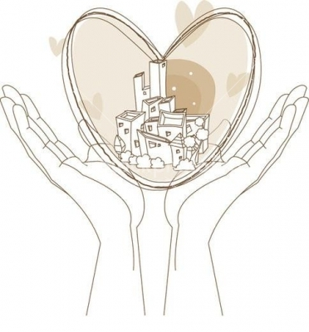
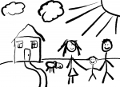
Life cycle of eco-community
Model ecovillage
Extension by new residents
First years
Initial stage

Slide 19
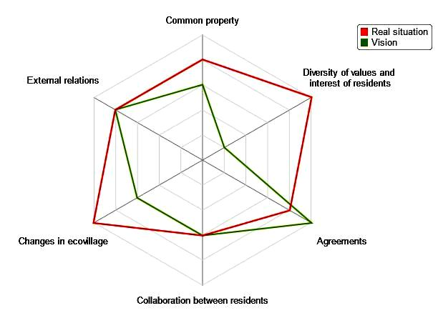
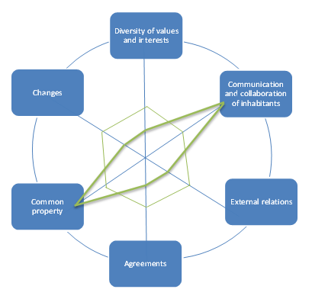
Self-assessment test
Ecovillage self-assessment on-line test for its socio-economic sustainability evaluation:
6 dimensions
Gap analysis
Vision vs. Real situation
Identification of week points
Short & detailed analysis

Slide 20
Self-assessment test
Read more and try the tests here: http://balticecovillages.eu/ecovillage-self-evaluation
Quick links:
Short analysis: www.balticecovillages.eu/node/add/survey-short-analysis
Detailed analysis: www.balticecovillages.eu/node/add/survey-detailed-analysis

Slide 21
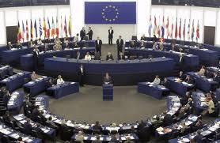
Recommendations
Recommendations for policy - makers concerning rural development based on the Ecovillage Movement ideas
www.kirkhope.org.uk/

Slide 22
Recommendations
Ecovillages project‘s proposal for EU Regulation 2014-2020 on sustainable rural development, which positions ecovillages as training and research centers for sustainable development. The proposal covers 8 measures:
• LEADER • Knowledge transfer and information actions • Advisory services, farm management and farm relief services” • Co-operation • Quality schemes for agricultural products and foodstuffs • Organic farming • Basic services and village renewal in rural areas • Farm and business development
Read the full proposal:
www.balticecovillages.eu/system/files/ecovillages_proposal_for_regulation_2014-2020.pdf

Slide 23
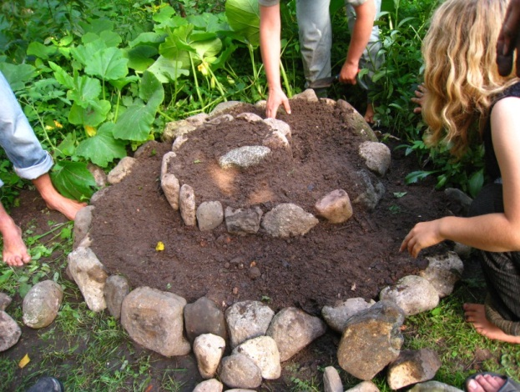
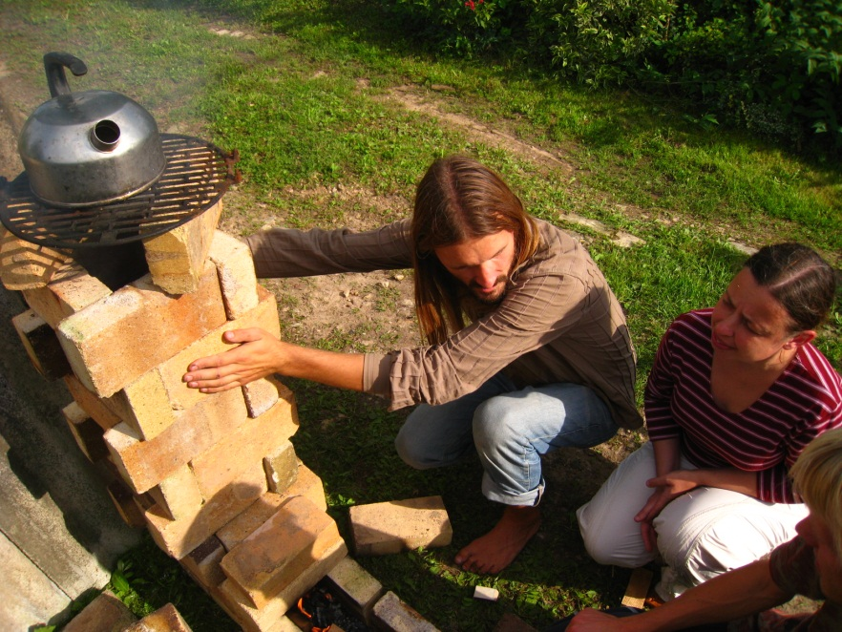
Internship programmes
Study tours and internship programs in ecovillages

Slide 24
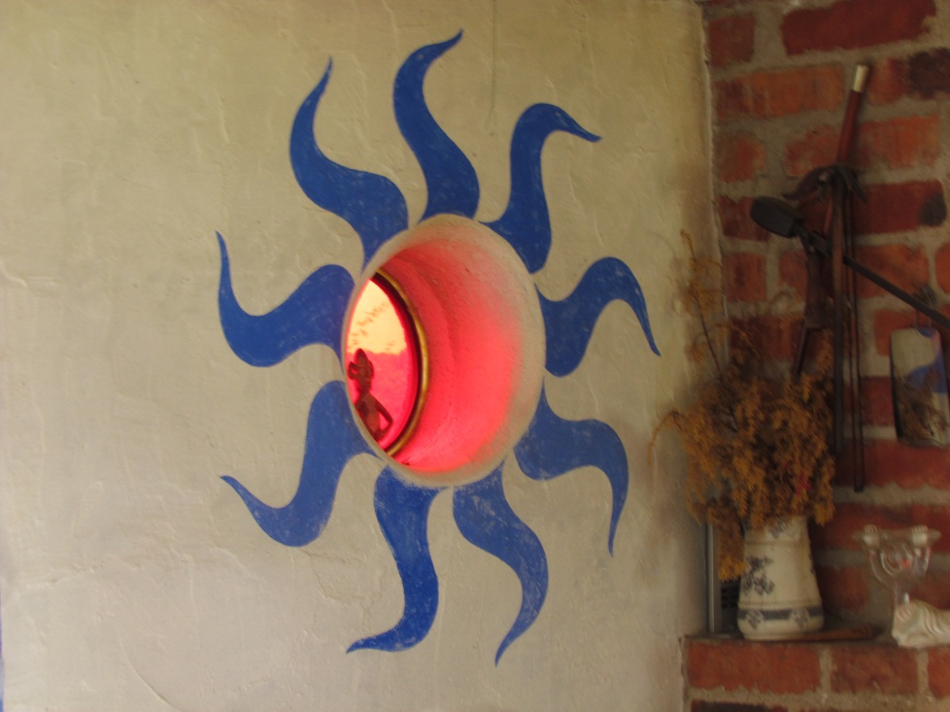
Internship programmes
Project‘s guidelines for internship programmes in ecovillages:
Background section
Preparation section
Execution section
Major schemes section
Minor schemes section
Own schemes section
Wrap-up section

Slide 25
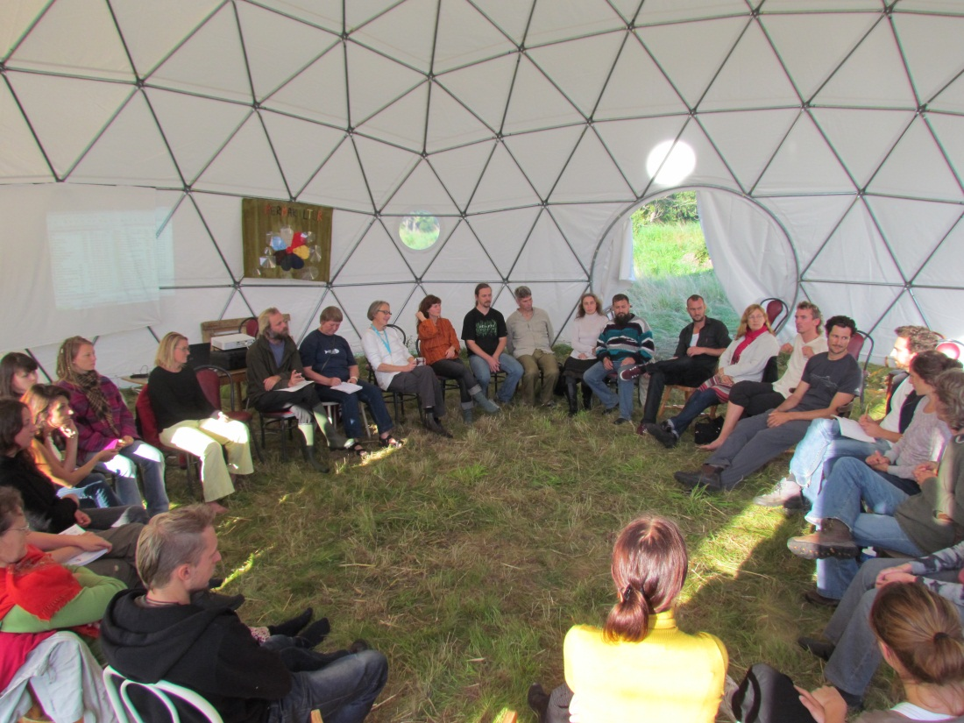
Ecovillage road
Ecovillage road – a virtual network aiming to gather valuable knowledge created through the Ecovillage Movement and to make it accessible to a broader public (www.ecovillageroad.eu)

Slide 26
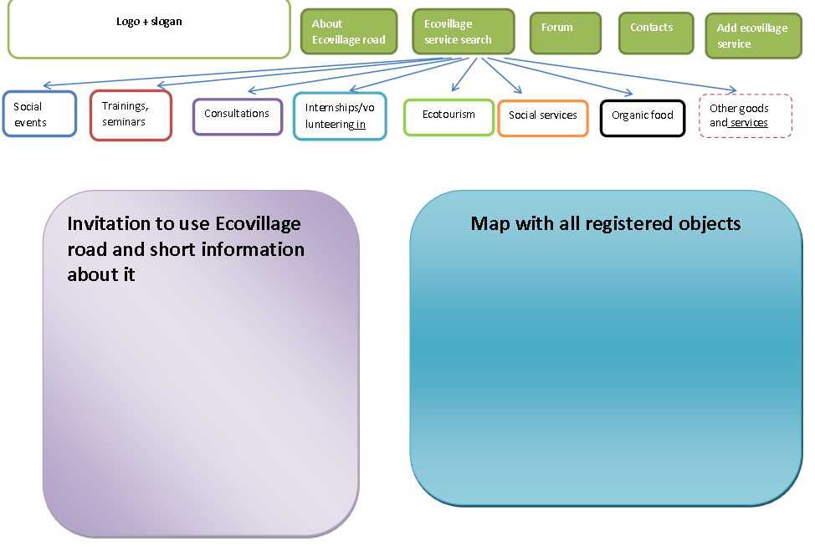
www.Ecovillageroad.eu

Slide 27
Project recognition
Project contributes to the EU’s Baltic Sea Strategy and its Action Plan by proposing environmentally sustainable ways of living
Project is recognized as Baltic 21 Lighthouse project

Slide 28
It is expected that project will help our society to get closer to nature again and to develop new ways of living together on the land in a genuinely more sustainable way.

Slide 29
10 ecovillages in 10 years in Norway. Why?

Slide 30
Contacts
Project manager
Zivile Gedminaite-Raudone +370 5 2617978 +370 68365994 zivile@laei.lt Lithuanian Institute of Agrarian Economics V. Kudirkos st., 18-2, LT-03105, Vilnius, Lithuania

Slide 31
For more information please visit www.balticecovillages.eu

